Slide 1

AI Interview Chatbot - Friday
Presented by
Patwari Raghottam

Slide 2
Overview of AI Interview Chatbot - Friday
Uses AI to conduct technical interviews
Supports Python and Machine Learning topics
Extracts questions from PDFs
Evaluates responses using NLP & AI models
Provides instant feedback & downloadable reports

Slide 3
Libraries Used
Streamlit – Builds the interactive UI for the chatbot.
OpenAI – Generates and evaluates interview questions.
PyPDF2 – Extracts text from PDF documents.
SpeechRecognition – Converts spoken answers to text.
Random – Selects random interview questions.
Pandas – Stores and processes user responses.
Sentence Transformers – Compares user answers using AI.
ReportLab – Creates and formats interview reports in PDF.
IO (BytesIO) – Handles in-memory PDF storage.
Groq – Alternative AI model for response evaluation.

Slide 4
Work Flow of FRIDAY AI Chatbot
1️⃣ User selects a topic & uploads PDF
2️⃣ AI extracts questions from the document
3️⃣ AI generates interview questions
4️⃣ User answers via text or voice
5️⃣ AI evaluates the response (semantic similarity & keywords)
6️⃣ Generates score & feedback
7️⃣ Generates downloadable interview report

Slide 5
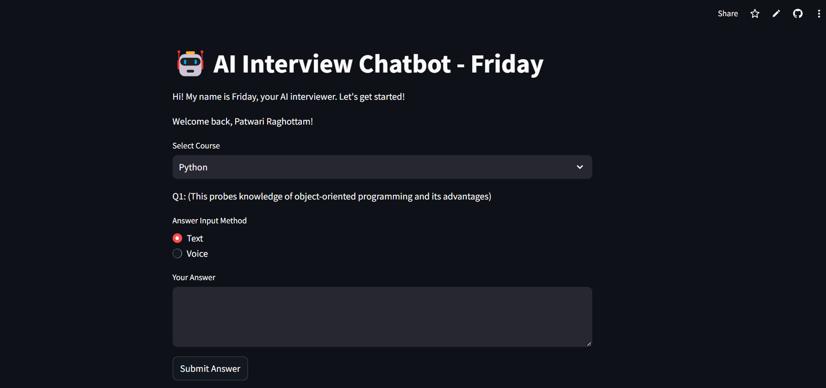
Deployment of AI Chatbot - Friday

Slide 6
Summary
AI-powered chatbot for interviews
Uses NLP, LLMs, and Speech Recognition
Evaluates responses & provides feedback
Generates detailed interview reports
Real-time, interactive, and user-friendly

Slide 7
THANK YOU

